Slide 1
Miss Devane’s Junior Infants
Important Information

Slide 2
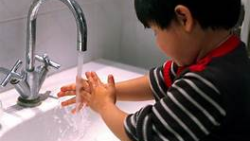
Hand Washing
We recommend that both parents and children all wash their hands at home before their arrival at school.
Notes:
NOTE: To change images on this slide, select a picture and delete it. Then click the Insert Picture icon in the placeholder to insert your own image.

Slide 3
Be on time! Hop into the line!
We ask infant parents to please bring children to the back of the school.
Parents will need to show their children where to line up on the green spot.
Children will be supervised by teacher and hand sanitiser will be given to each child before entering the classroom.
Notes:
NOTE: To change images on this slide, select a picture and delete it. Then click the Insert Picture icon in the placeholder to insert your own image.

Slide 4
Class Times
Junior Infants start at 9.30 am, please do not come any earlier as all other classes will be entering the building from 9.
Junior Infants are to be collected at 12 o clock for the first two weeks
Junior Infants must be collected at 1.55 thereafter. Please be on time as Senior Infants can not come onto the yard until all Junior Infants can be collected.

Slide 5



Dropping & Collecting
We ask that only one parent drops and collects their child please. We have a designated area where we recommend that parents stop, drop, high 5 and go.
Notes:
NOTE: To change images on this slide, select a picture and delete it. Then click the Insert Picture icon in the placeholder to insert your own image.

Slide 6
One Way Entrance & Exit
Parents please be aware of the gates with entrance and exit on them and ensure they are used correctly.
Also to please be aware of the 2 meter social distance requirement we recommend parents use at all times

Slide 7
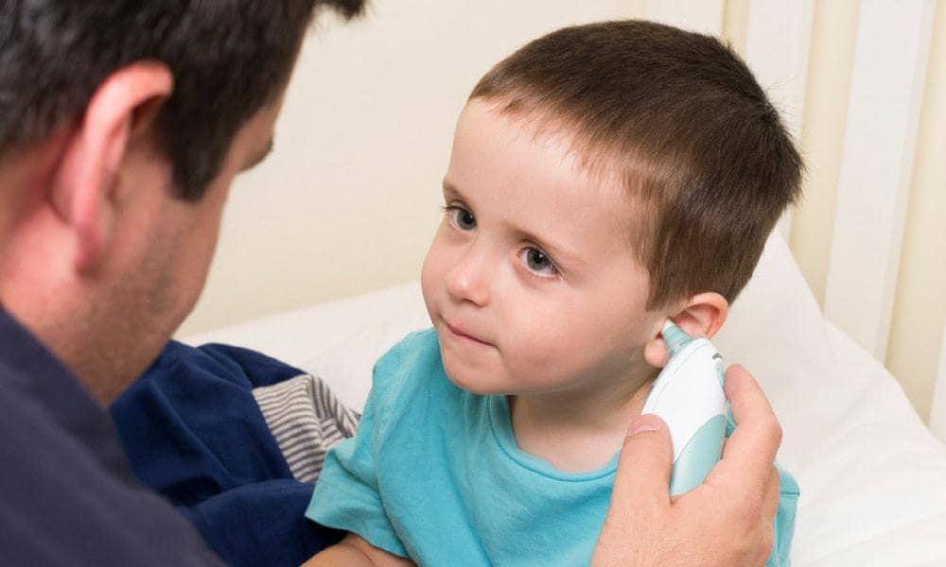
Temperature
We ask that parents please take their child’s temperature each day before attending school as this can cause less destress for the child if a parent does it rather than a teacher.
Please see Advice for Parents from HSE sent on the 27/08/2020

Slide 8
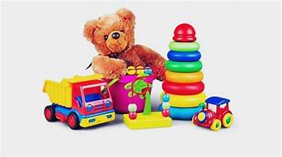
Belongings From Home
We advise that parents do not allow their child to bring toys from home.
We also can not allow extra items such as food/clothes for childminders etc to be left on the premises.

Slide 9
Our Bubble
Junior Infant Bubble
Currently there are 22 children in Junior Infants.
The only adults allowed into the bubble are Ms. Devane, Ms. Kinnarney and Michelle, the class S.N.A.
No other adult is allowed to enter the Junior Infant Room.
Please do not be offended if you are not permitted to enter our room.
As we learn more about Covid and back to school we hope to welcome you to a more regular school experience in the future.

Slide 10
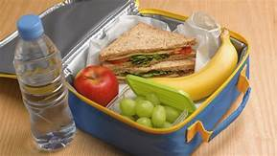
Lunch
We ask when parents are packing their child’s lunch to ensure that their child has their own bag, lunch box and drink all LABELLED and that their child can open and access their own lunch easily.
Adult contact with their food i.e. opening yogurts, peeling fruit has to be kept to a minimum.

Slide 11
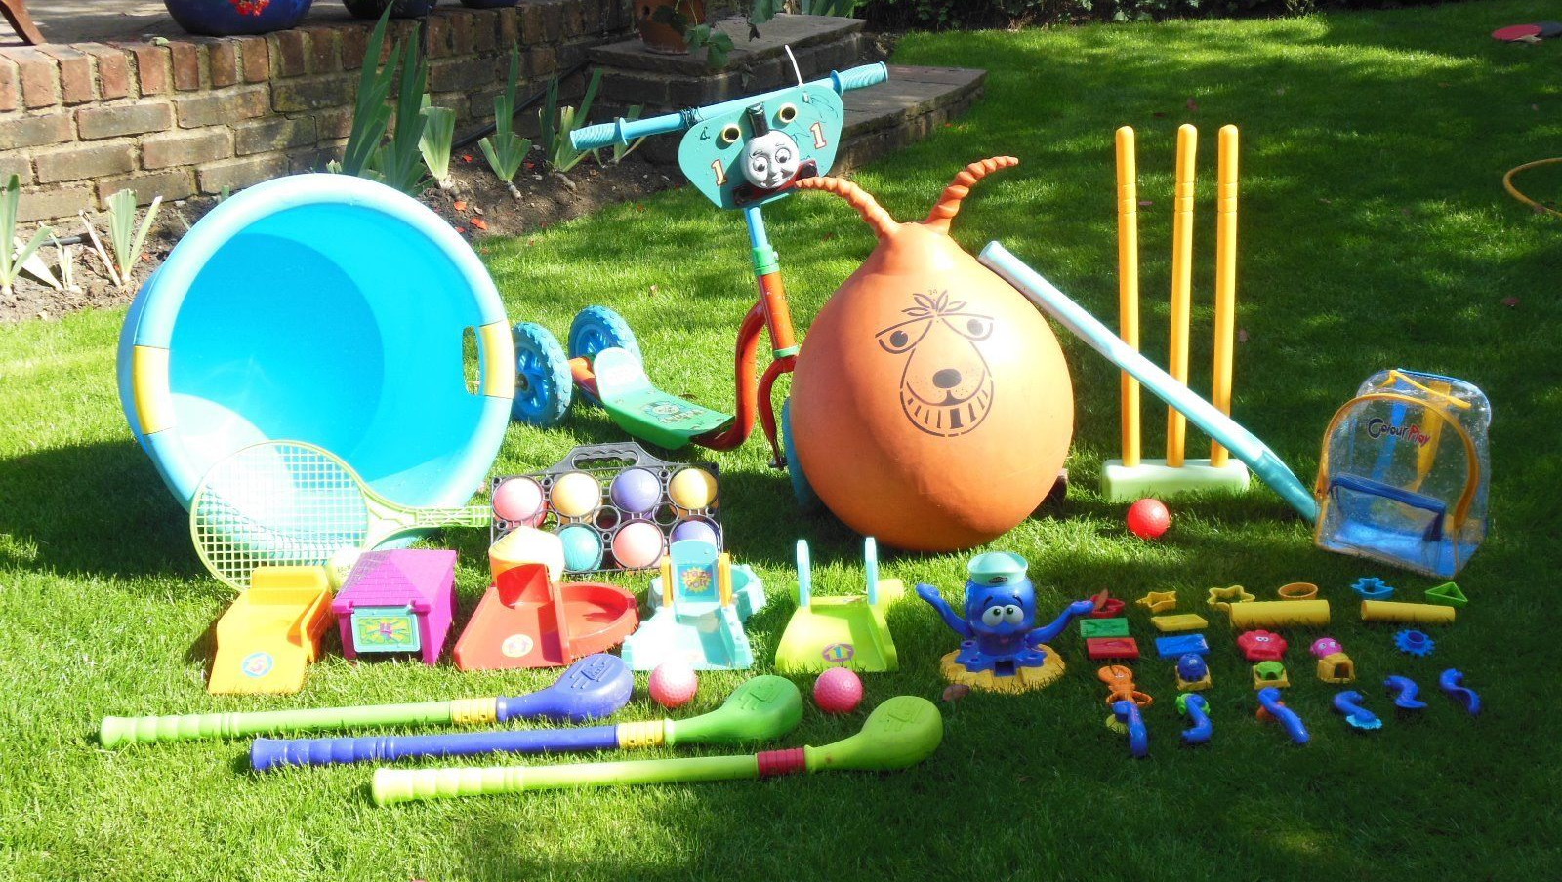
Outdoor
We plan to use our outdoor spaces frequently throughout the day- including going outside for singing, action rhymes and dance.
If parents could please ensure that they leave a light rain jacket in their sons bag until the weather changes, it would be very helpful.

Slide 12
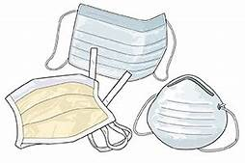
PPE Gear
Under the guidelines it is recommended that staff wear visors outdoors and a visor and mask indoors.
As a parent if you feel comfortable wearing one while dropping and collecting please do so.

Slide 13
Transition Back From Covid
Parents please do not hesitate to contact us by emailing or leaving a message on the school phone and we will respond as soon as we can.
Class Dojo and Aladdin communication apps will be organised for the class shortly. This will allow direct messaging to the class teacher.
Looking forward to seeing everyone soon. Stay Safe

